Slide 1
HETS Horizontal Thrust Structure CDR
POCs:
Bhaskar Jain – Lead
Mohammed Al-Mahrouqi - RE

Slide 2
Outline
Requirements & Considerations
Overview
Design & Analysis
Thrust Structure
Blast Sheild
Logistics
Transportation
BOM
Timeline

Slide 3
Engine Testing Requirements
HETS Requirements
The system shall be capable of testing engines for the Daedalus vehicle
The system’s thrust structure shall be able to support 10,000lbf of thrust*
The thrust structure must not be the root cause of any engine anomalies
The thrust structure shall allow for engines of different sizes and configurations to be mounted
The thrust structure shall constrain off-axis force while allowing linear force data to be collected
All components of the thrust structure shall have a minimum FOS of 3
The thrust structure shall not apply the main thrust load directly to the system holding the fluids
*Given testing site is unknown right now, concrete vs soil is the only thing not rated for this

Slide 4
Frequency Requirements
The system shall support rapid engine testing
The system shall be transportable to and from test sites potentially far from Atlanta
The system must be capable of multiple hot fire tests in a single day
The system shall be modular
The thrust structure must have the ability to mount multiple engines of different sizes for testing purposes
The system shall use standardized mounting systems to allow lines and components to be replaced
The system must not require assembly at the beginning of each test
All components of the system that are required to be insulated shall remain insulated if they are required on the system

Slide 5
Other Considerations
Overall Requirements
Horizontal
Engine nozzle 1ft from ground for plume
Can be mounted via earth anchors or concrete
Engines up to 14” diameter
Space for propellant lines and fittings
Be able to test
Subscale Heatsink, Ablative, Regen
Vespula Heatsink, Ablative, Regen
Darcy Space
Environmental Requirements
Everything painted for corrosion resistance
COTS parts are rated for outdoor usage
Tarp to cover system

Slide 6
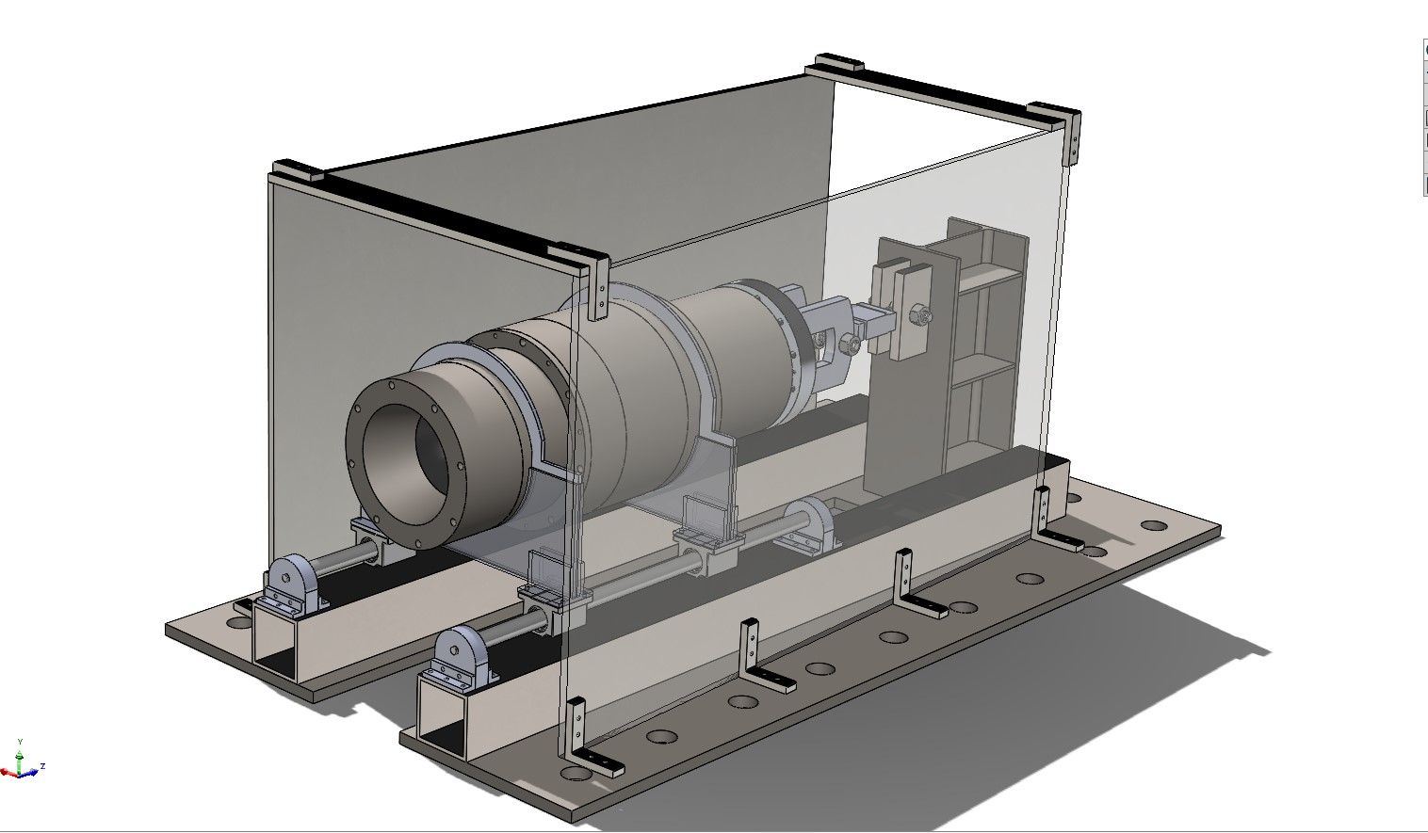
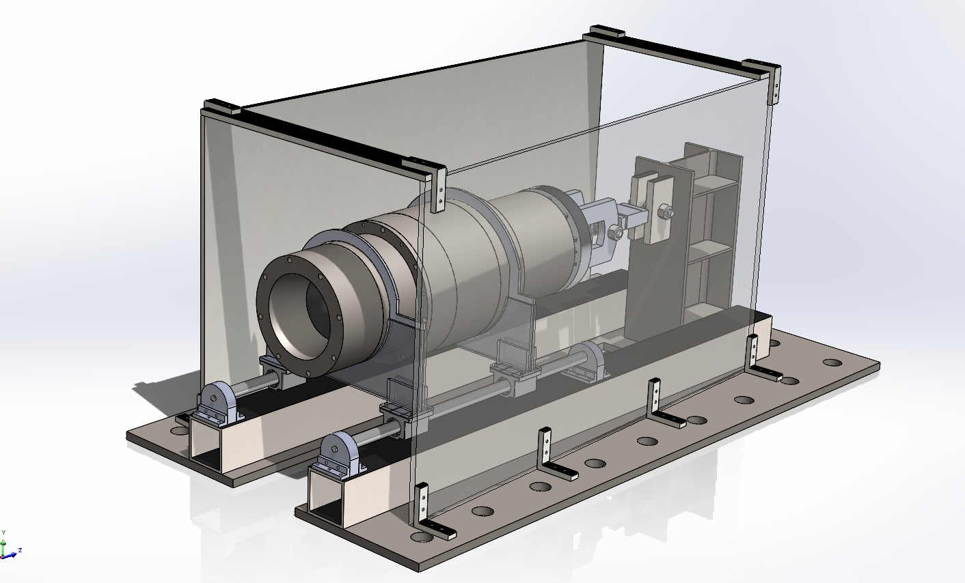
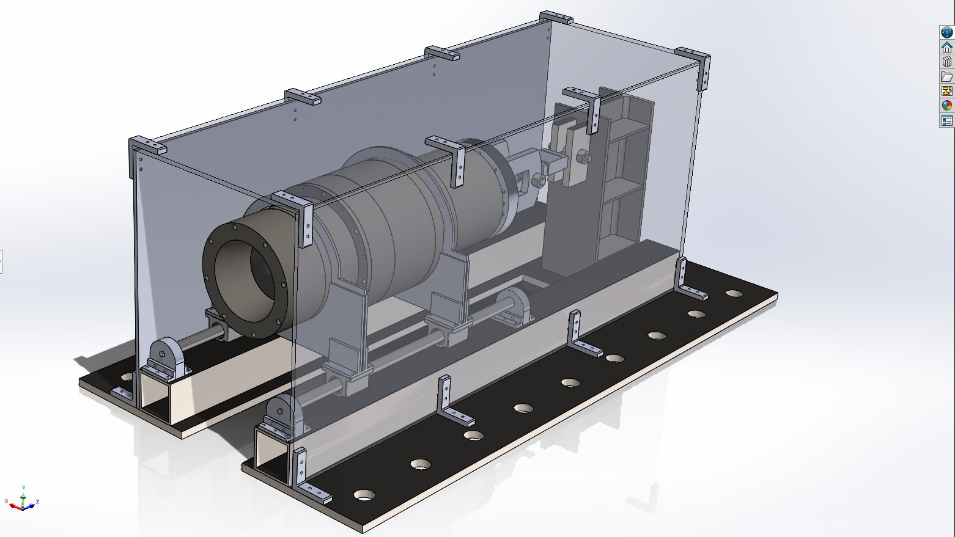
System Overview
I Beam will handle all deflection
Mostly welds
Fluids should mount easily
Main Features
Railing
Bearings
Rings
Brackets
Ball Joints
Load Cells
I beam

Slide 7
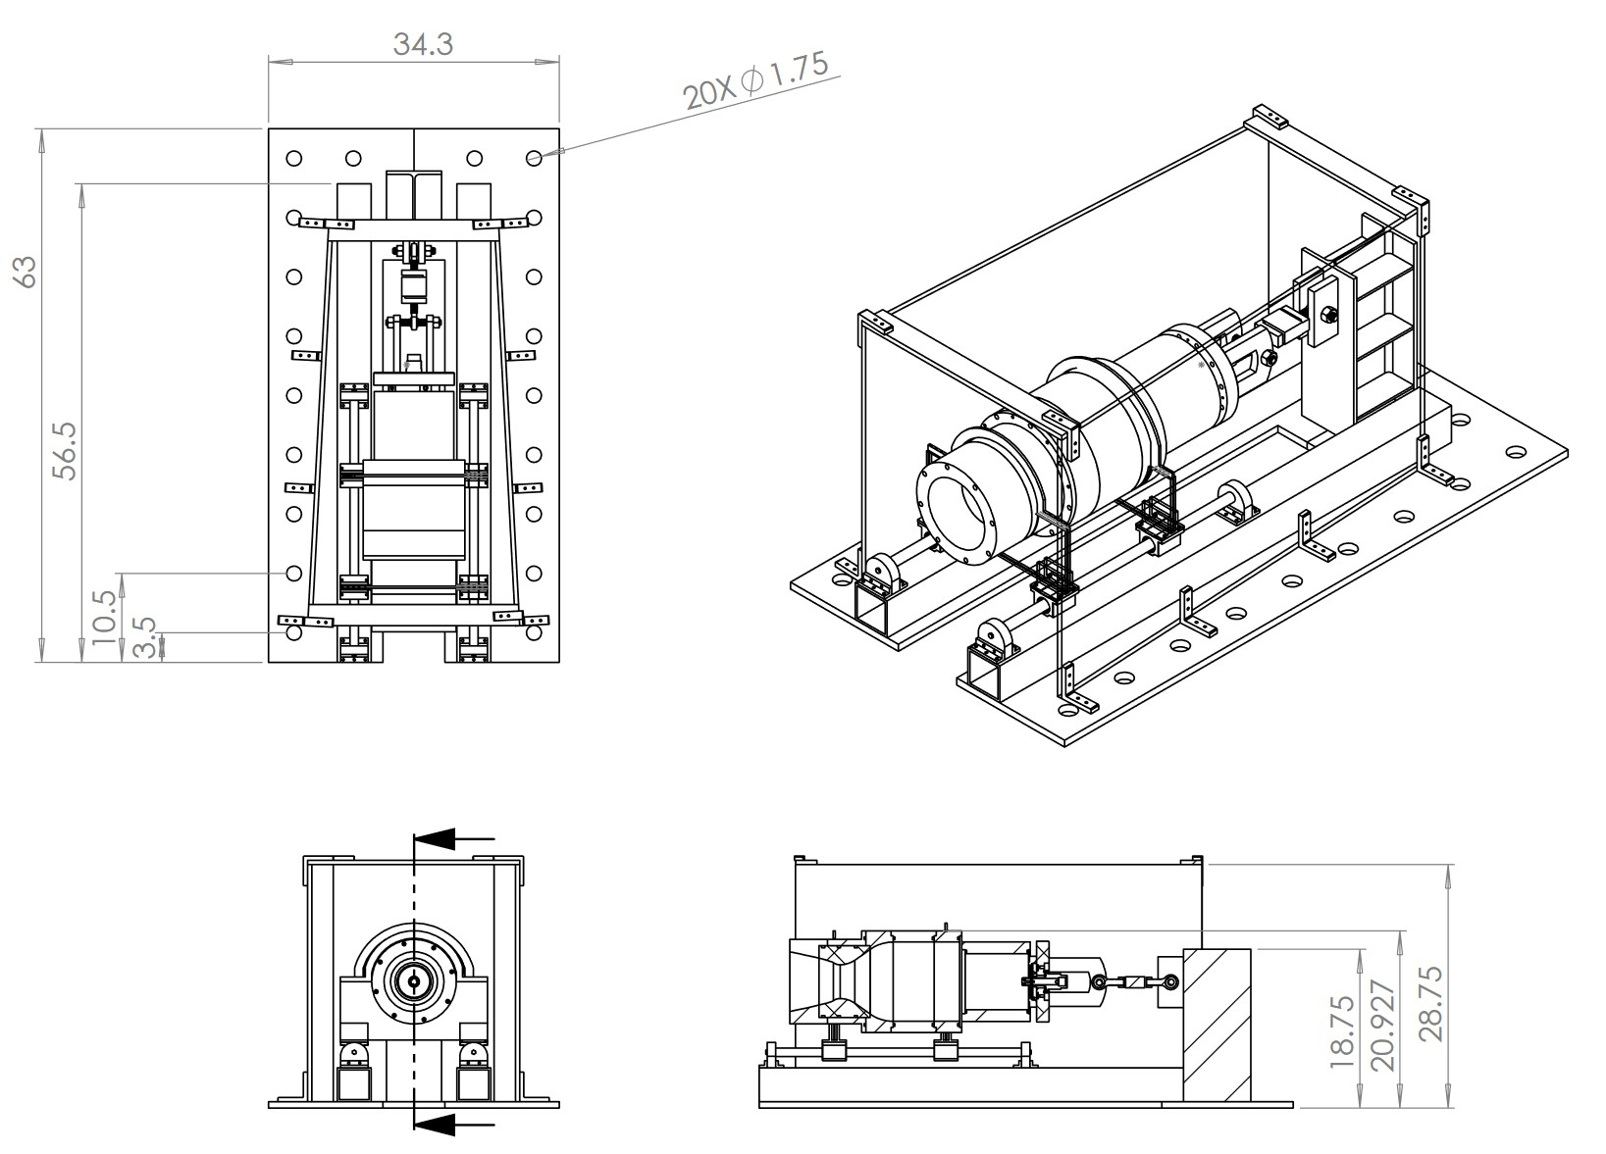
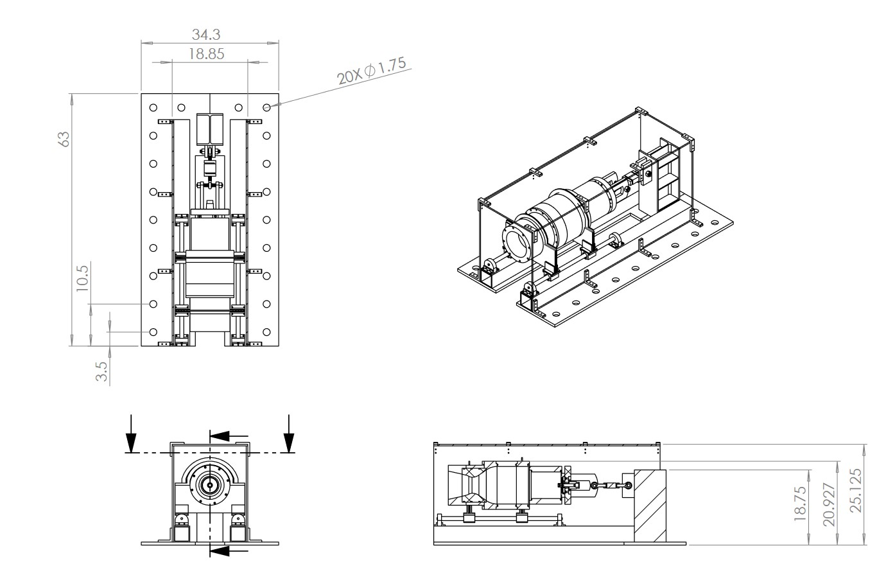
System Overview: Dimensions
Total height: 28.75”
Height from center of engine to ground: ~14.93”
Length: 63"
Width: 34.3”
Spacing of Earth Anchors: 14”
Estimated Total Mass 346.26 kg (+- 5%)
Blast Shield: 185.08576 kg
Ground Plates 56.44 kg
Others 104.72 kg

Slide 8
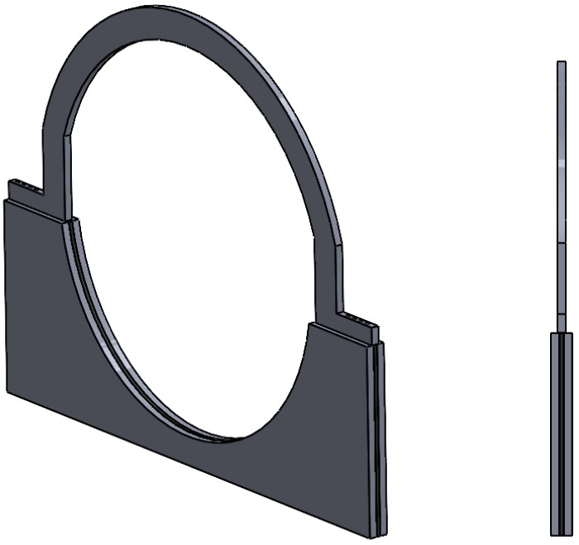
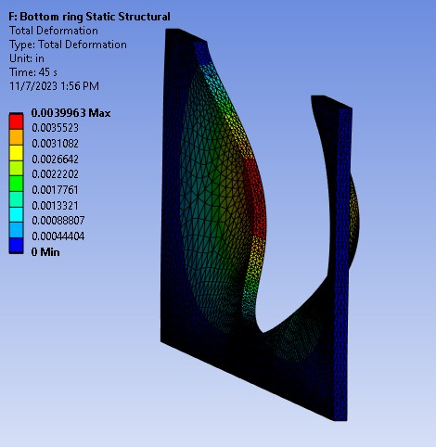
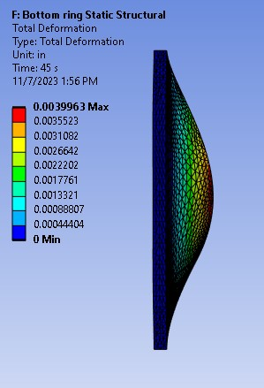
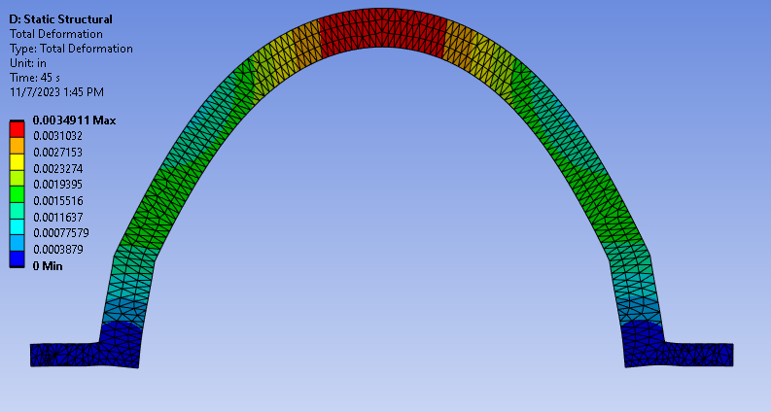
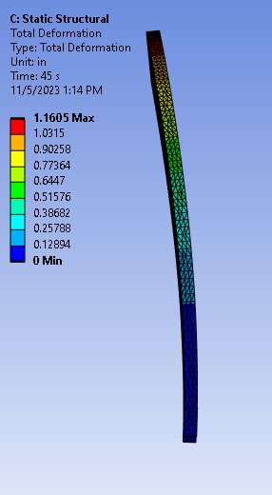
Design: Rings
Two plates on the bottom, one on top
Shear Load of 1000lbf ;
Ring top max. deformation: 1.1605 in
Ring bottom max. deformation: .0042452 in
(won't really experience shear load, only vertical load)
3D printed spacer (with holes to screw everything in into)
0.25”
0.125”
Ring Bottom Piece
Ring Top Piece
1K lbf Shear Load
1K lbf Shear Load
1k lbf Vertical Load
1K lbf Shear Load

Slide 9
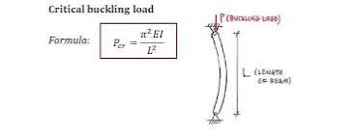
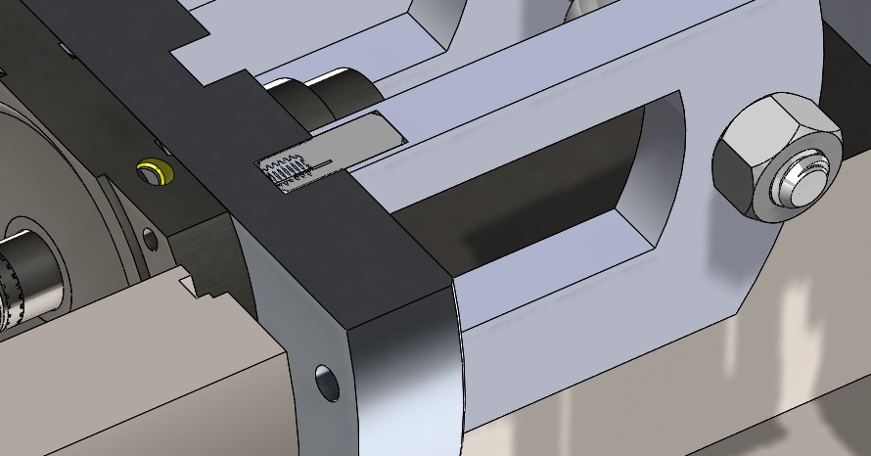
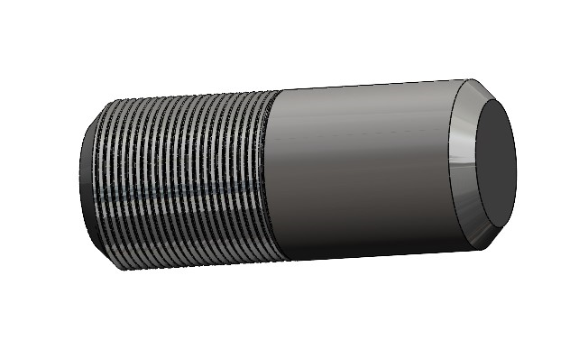
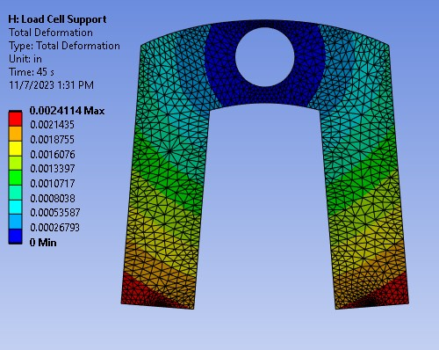
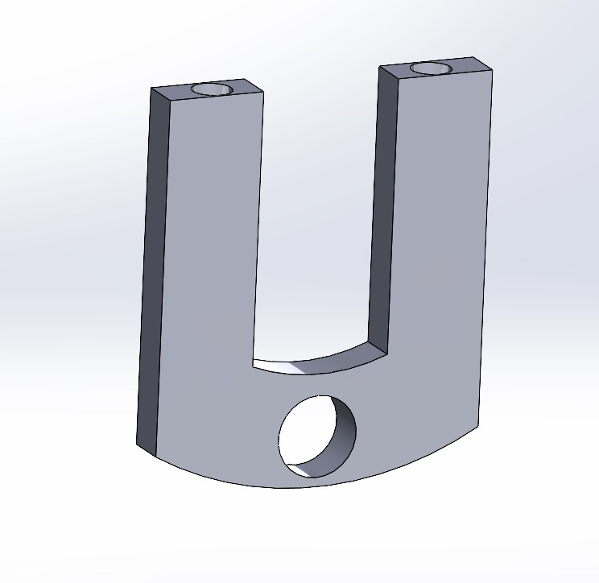
Brackets
Motivation: need room for fluids, connects rings to Load Cell
Carbon Steel (waterjetting)
Outer Arc: R 5.76”
Inner Arc: R 3.26”
Gap Width: 2.389”
Top Hole: D 0.75”
Side Holes: D 0.68”
Able to handle load?
Euler Buckling on one segment, one fixed and one free end
Pcr = 8290 lbf x 4 = 33160 lbf >> 10k lbf
5k lbf Normal Load

Slide 10
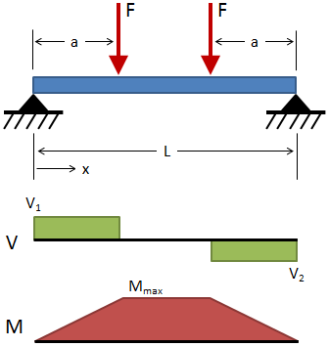
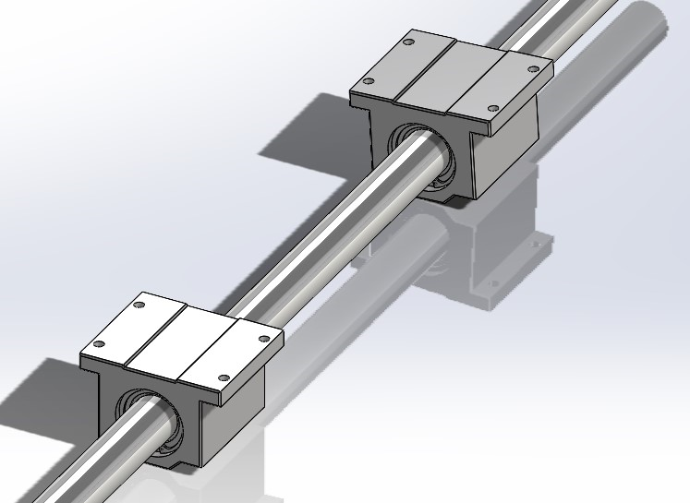
COTS Bearings and Shaft
304 Stainless Steel Rods from McMaster (2x~$50)
Corrosion resistant up to 1500F
2 Forces Loading Case: max deflection at L/2= .05in with 2000lbf (will likely be closer to 200-300lbf nominal)
Deflection Calculations Lines 1-8
1" Bearings (4x~$100)
Dynamic Load rating: 850lbf
4x850=3500lbf >> 1000lbf off axis + ~200 lbf engine weight
Self-aligning bearings compensate for shaft misalignment <= 1deg

Slide 11
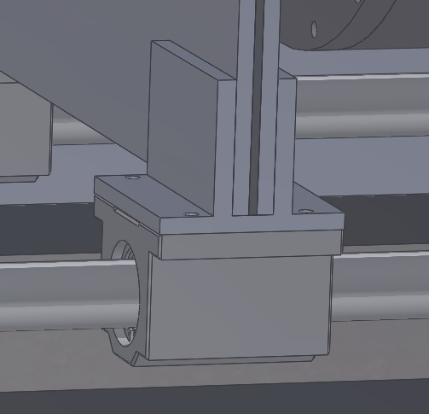
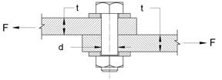
Bearing Brackets
Connect the rings to the bearings
Cantilevered Beam Analysis:
1000lbf acting at the edge of the bracket: deflects ~0.002 in.
Close up of bolts attaching the bearings to the rings
1000lbf per bolt, shear stress / bolt = (allowable stress = 40000 lbf/in^2)
Will mill these with angle iron stock

Slide 12
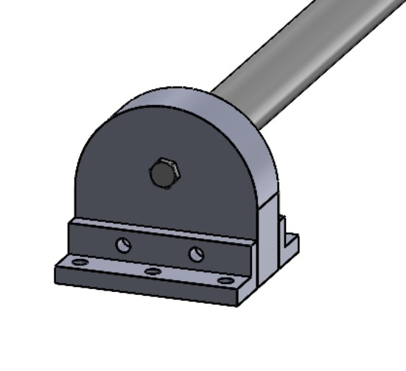
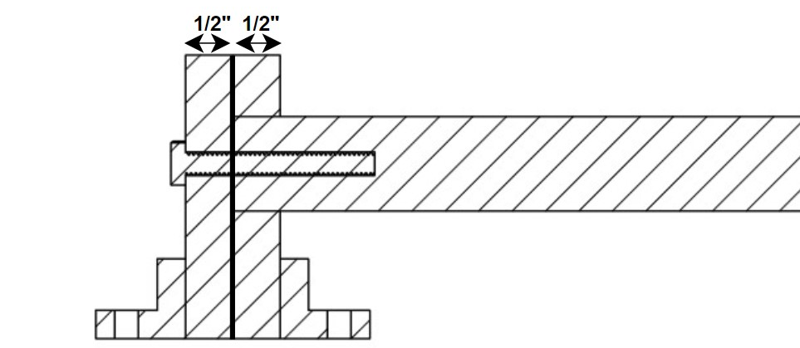
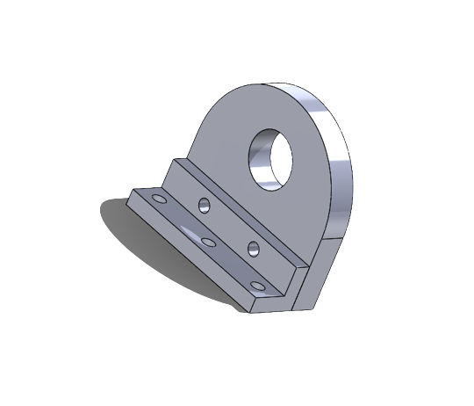
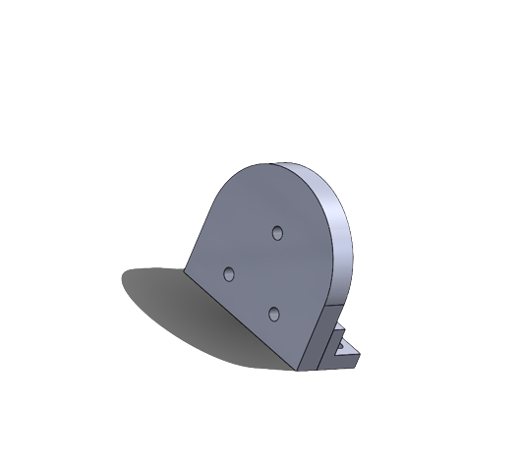
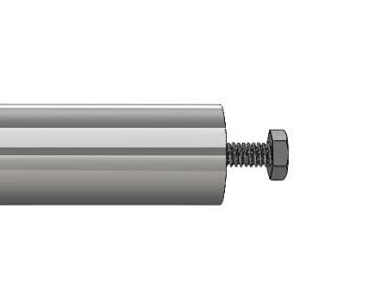
Shaft End Supports
Screw holes are slotted so we can easily align the rods to make them parallel (if we machine things outside of 1deg tolerance)
¼-20 screws to bolt the rod to these shaft end supports
For a 1000lbf load acting on just one of the bolts: 20ksi stress (65ksi allowable, FOS=2)
1000 being distributed across 4 bolts. No chance of failure
Shaft end supports
Made from 2x ½" carbon steel plates (cost optimal)
First plate has a larger hole for the rod to sit on
Brackets
Angle Iron
Machining: mill

Slide 13
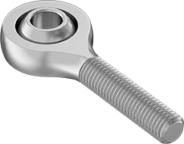
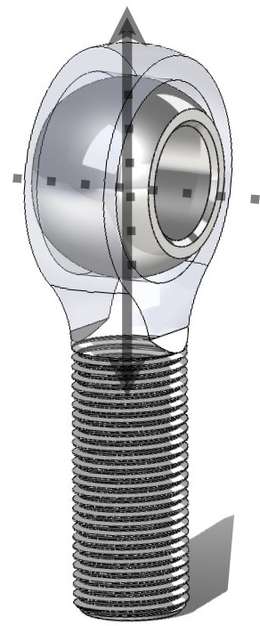
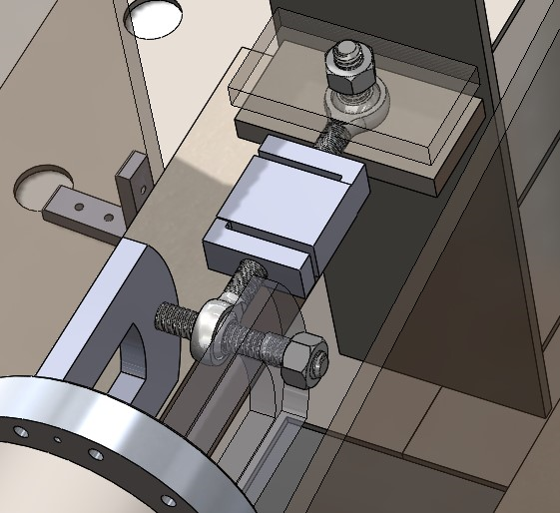
Ball Joints
Ball Joint Rod End, 3/4"-16
Rated for 15.850lbf ($15.33 per)
Only really need to rate this for off axis forces, the 10,000 lbf would go axially through the rod, but other requirements drove the large size
Requires lubrication
Zinc plated: moderate corrosion resistance
Chose this size because it directly interfaces with the Load Cell
Bolt Calcs: 65ksi allowed, FOS of 2
½" --> 51ksi stress / bolt ($10.20)
¼" --> 203ksi stress / bolt (would fail) ($5.43)
¾" --> 22ksi stress / bolt ($15.33)
Design has 2 in perpendicular directions so that the entire load of the engine is in one direction
prevents off axis forces
More accurate reading

Slide 14
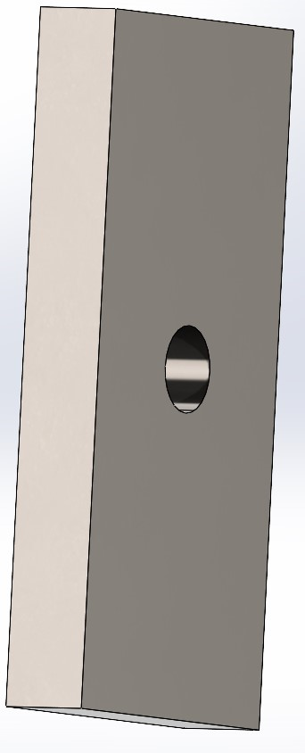
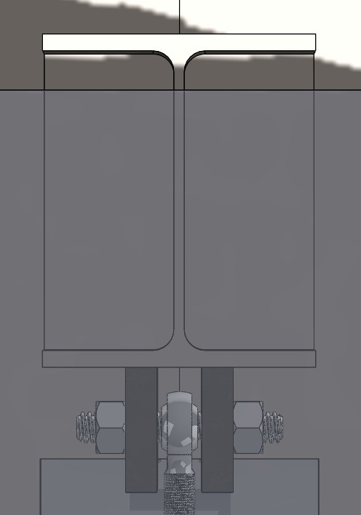
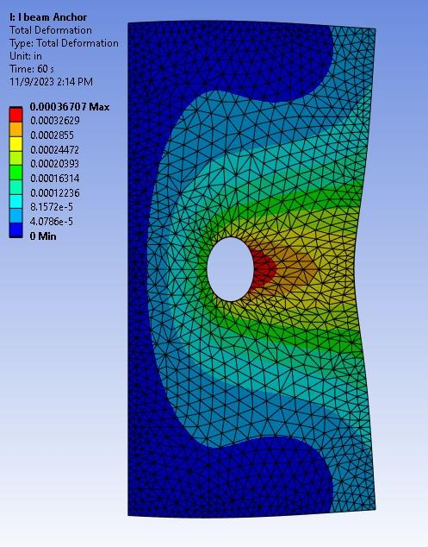
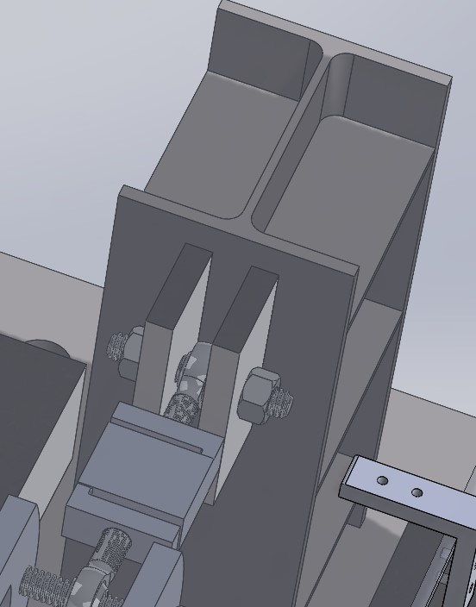
Design: Ball Joint Connector
Motivation: need to connect ball joint to I-beam
Analysis:
3.6707e-004 in Max. Deformation for 10K lbf.
1.8354e-004 in Mas. Deformation for 5K lbf considering 2 supports transmitting 10K lb. to I-Beam
Threaded rod with nuts locking up the support with the ball joint.
Manufacturing:
Connect three 1/8" plates together and then weld that assembly to the I-beam.
10K lbf Load

Slide 15
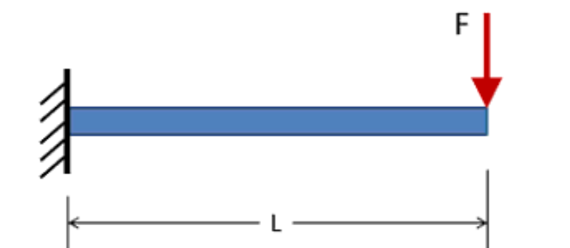
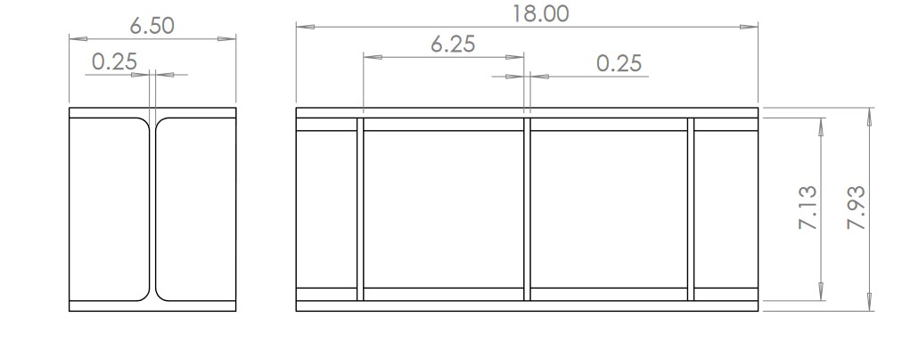
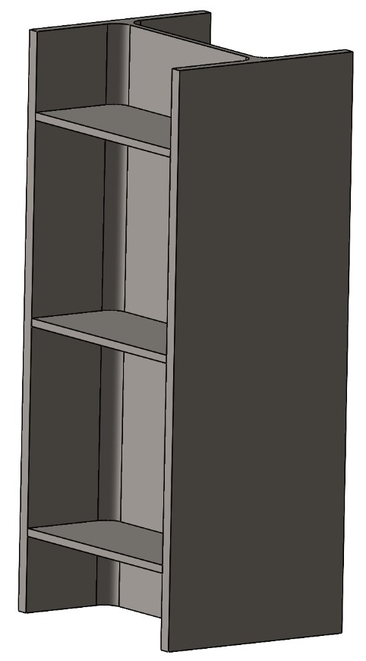
I Beam
W8x24 I-Beam, 18" Long, ~$58.54, Ixx=82.8
Cantilever beam deflection done on beam
Deflection at 14in with 10,000lbf = .00544in ; 50,000lbf = .027in
Even with any potential dynamic loading cases, this will be sturdy
I Beam Deflection Calculations, Lines 9-16
To account for I beam flange deflection, we will weld plates onto it, wherever the load is being attached.
Euler Buckling on those flanges: Pcr = 408 Mlbf. Will not fail compared to 10klbf load max
Calculations, Lines 17-20

Slide 16
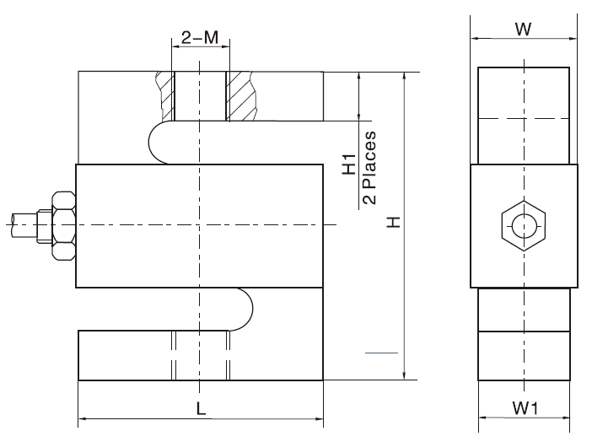
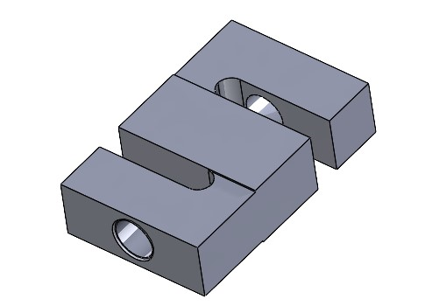
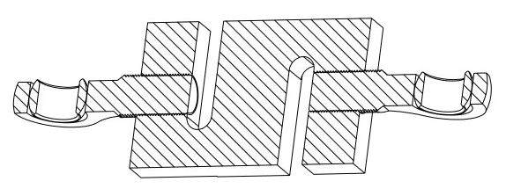
Load Cell
1 10k lbf Load Cell mounted to prevent static indeterminacy
Interfaces with our electrical system (already have 1)
Rated for 10,000lbf ±0.02% ($380.25)
Can safely go up to 15,000lbf without any failure
Rated IP67: anti-corrosion
No ingress of dust; complete protection against contact.
Immersion up to 1m in water (will be fine outside)

Slide 17
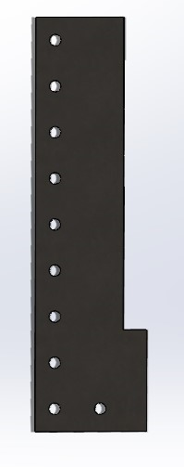
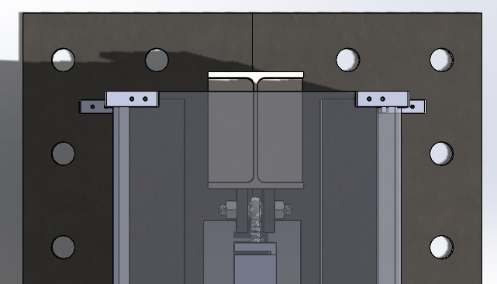
Ground Plate
Weld Calcs
Assuming E60 electrode is used
Top plate to main beams:
Net force on each of four welds: 11.127N = 2.5014 kips
Weld sizing: 0.5625 in. Fillet weld leg --> minimum 5/16"
60 in. Weld on each side of main beams
I-Beam:
Net Force on welds = 10000 lbf
Weld sizing: 0.39 in. - 0.6075 in. Fillet weld leg --> minimum 5/16"
72.56 in weld

Slide 18
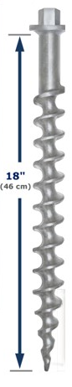
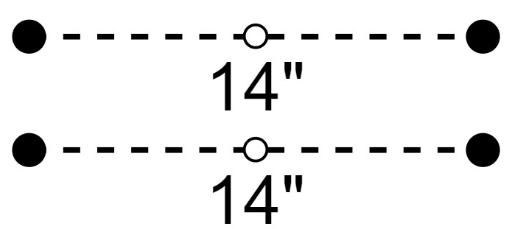
Earth Anchors
Penetrators
18” Penetrators
Parameter | Value | Note
Length | 20” | Corrosion-resistant cast Aluminum
Diameter | 1 3/4”
Inclination Angle | 0 | Minimal soil disturbance (unlike helical anchors)
Spacing |  | Use wrench to install Two rows, with 5 anchors in ea.
Load
Parameter | Description | Note
Axial Load Capacity | 350 lbf (loose soil) vs 2500 lbf (grout/asphalt) | Per anchor Per anchor
Lateral Load Capacity | 510 lbf (loose soil) | Per anchor

Slide 19
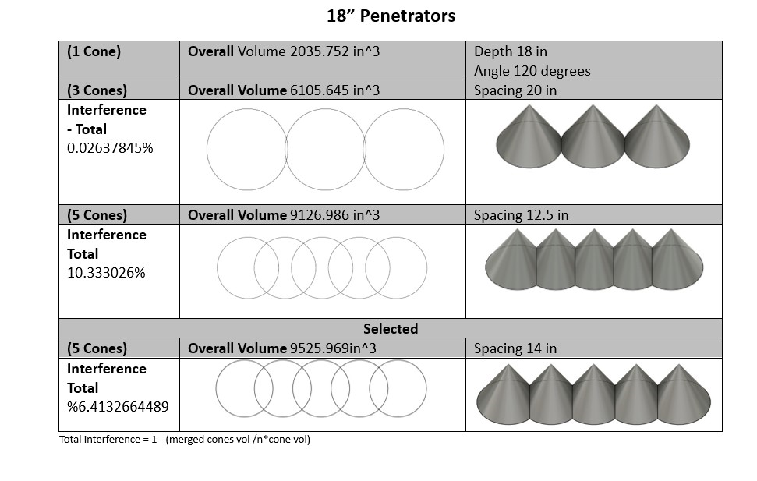
Earth Anchors
Assuming that EA Load is linearly corrrelated to volume:
Max Load in loose soil with 3: 1530lbf; Max Load with 5 = 2287lbf.
Same numbers for concrete. 3: 10925lbf and 5: 16332 lbf
For subscale testing, we can use soil, but for engines >1500lbf, we won't be able to.
would need to pour our own concrete or find a testing site that has concrete we can go into

Slide 20
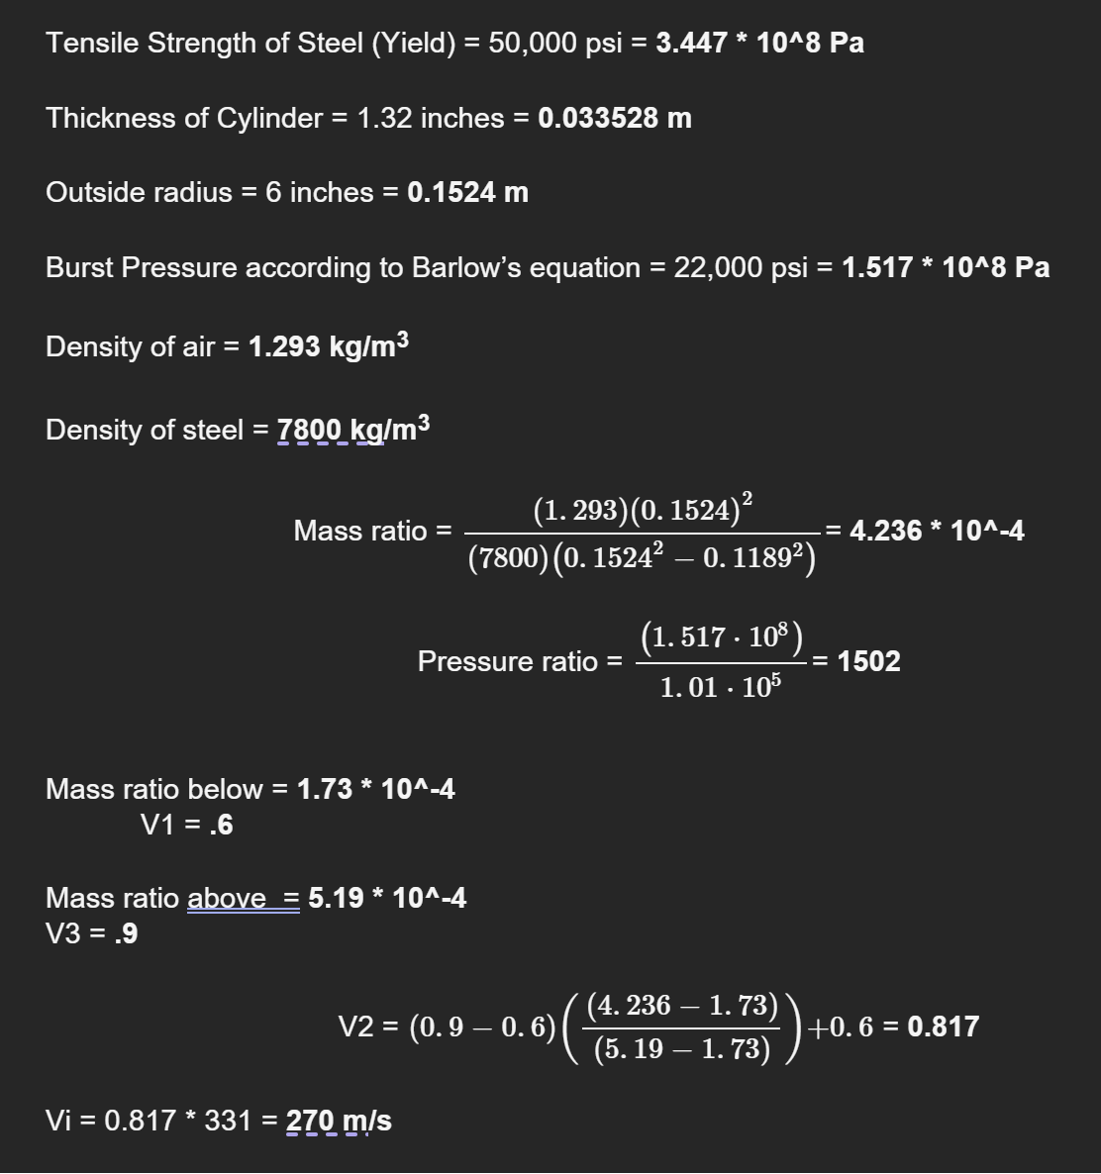
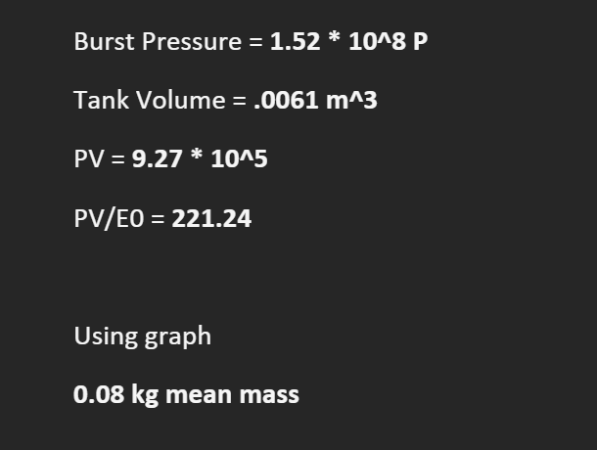
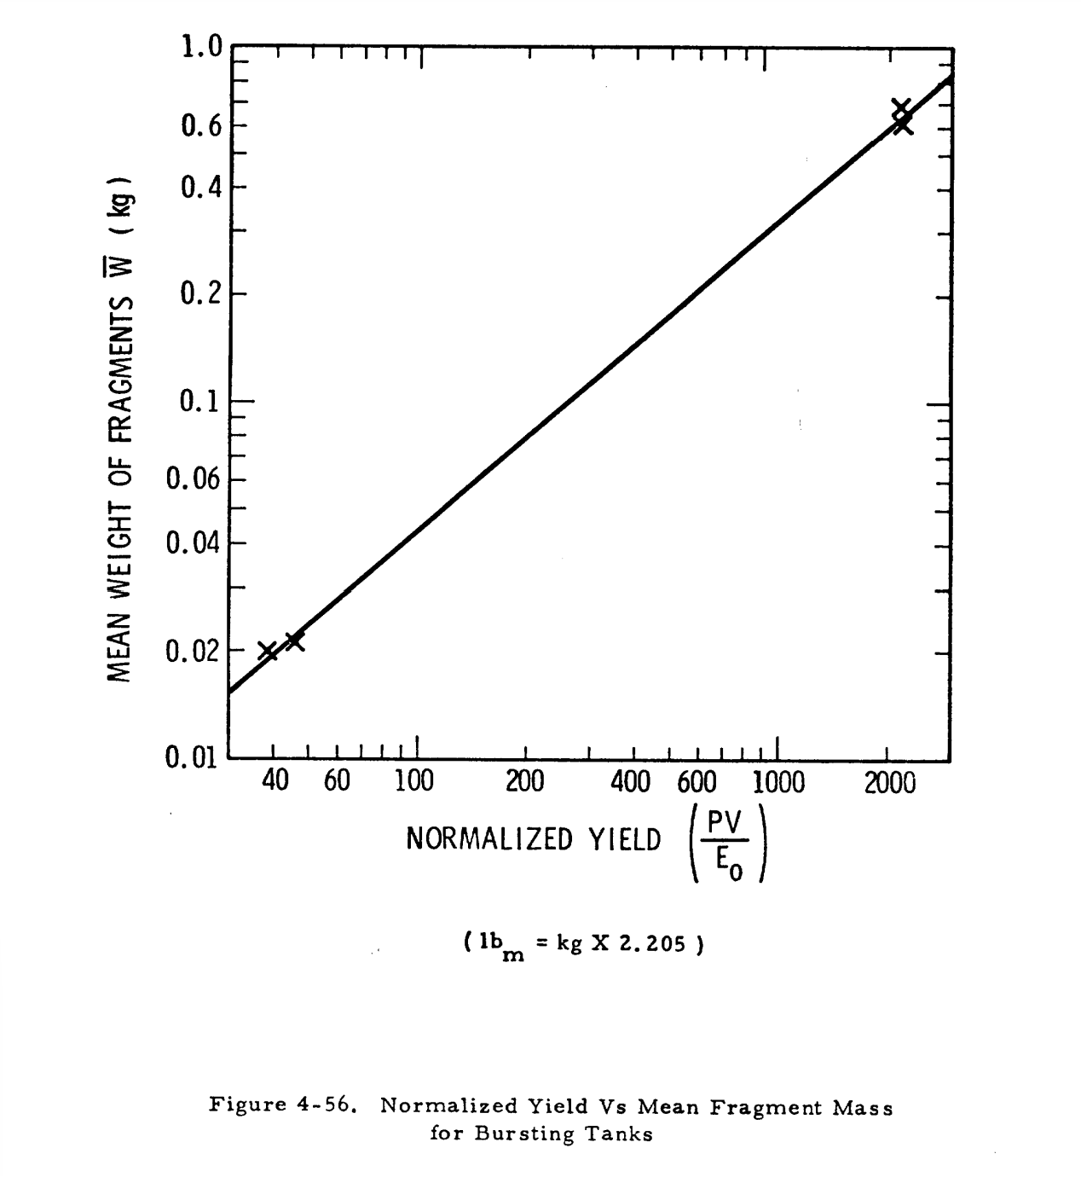
Sizing Blast Shield
Calculating Initial Speed + Mass of Fragments
Taken from NASA Paper, treating the engine like a pressure vessel
Velocity = 270 m/s
Mass = 80g
KE = 2916J
Looking at equivalent plates for bullets:
6.5 Creedmoor rounds with a KE of 3380J are stopped comfortably by a 3/8" steel plate
5.56 rounds go through a ¼" steel plate with a KE of 1767J
Therefore 3/8" is the minimum measurement for thickness

Slide 21
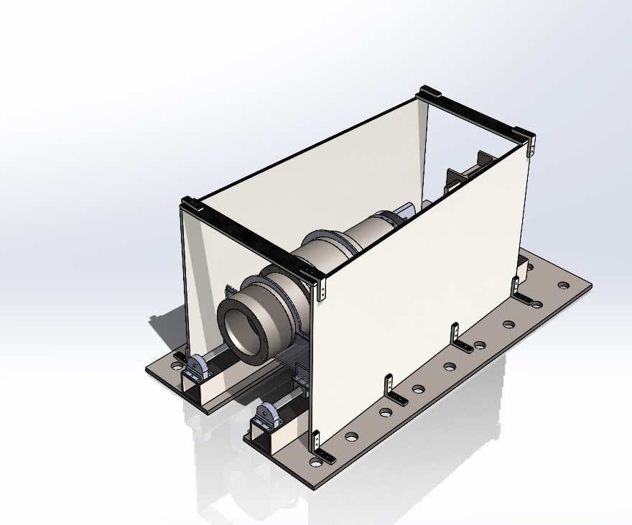
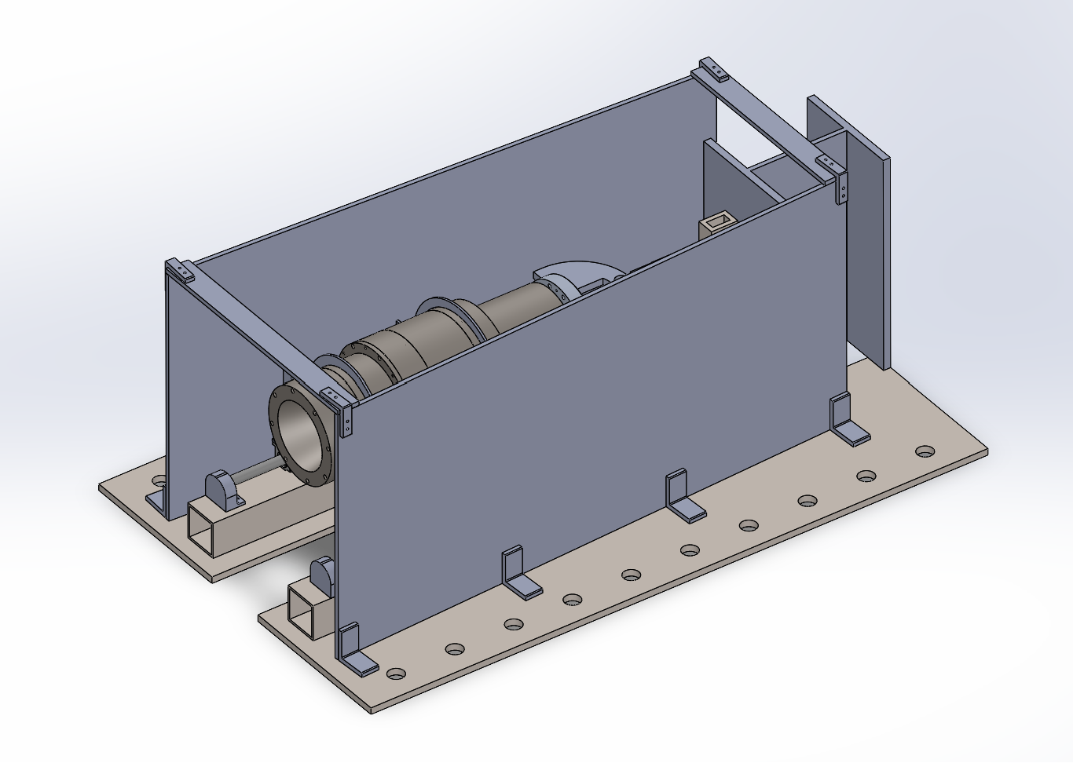
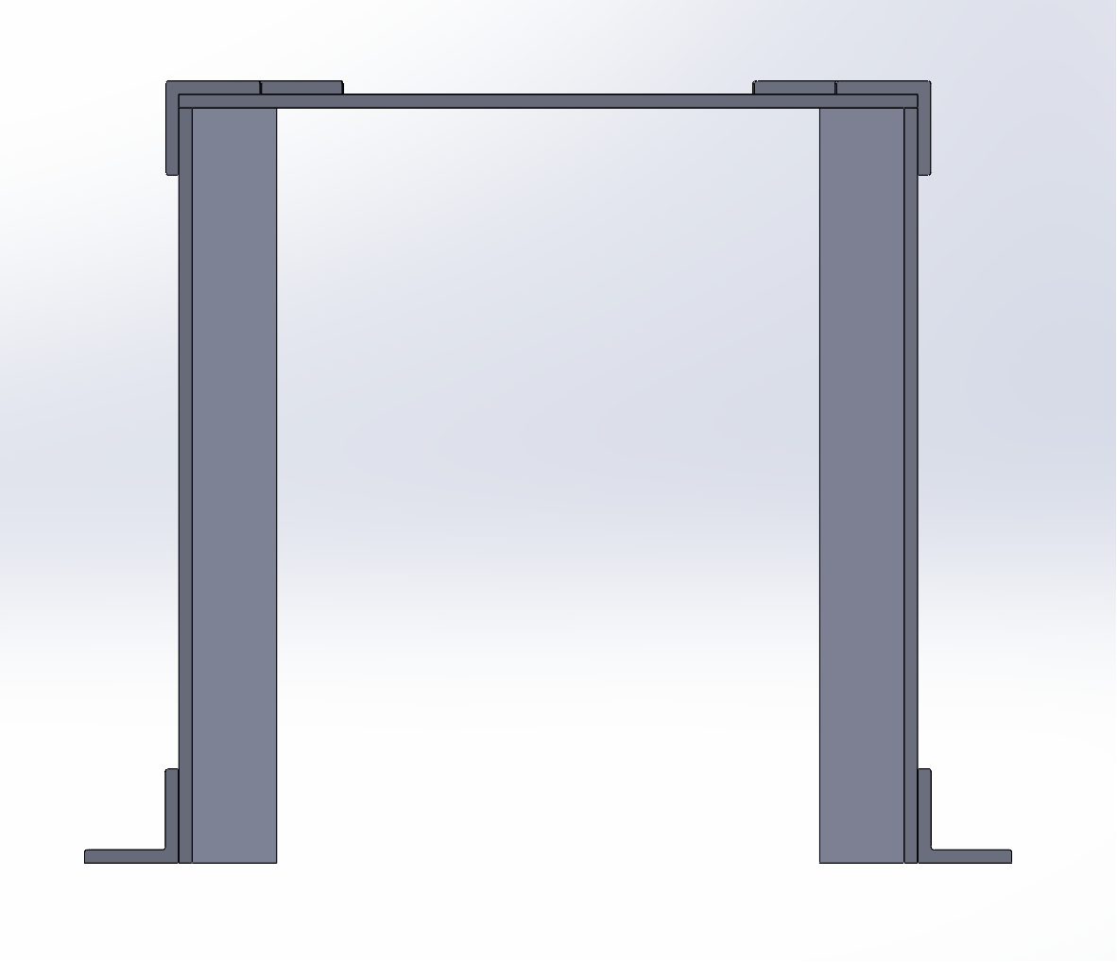
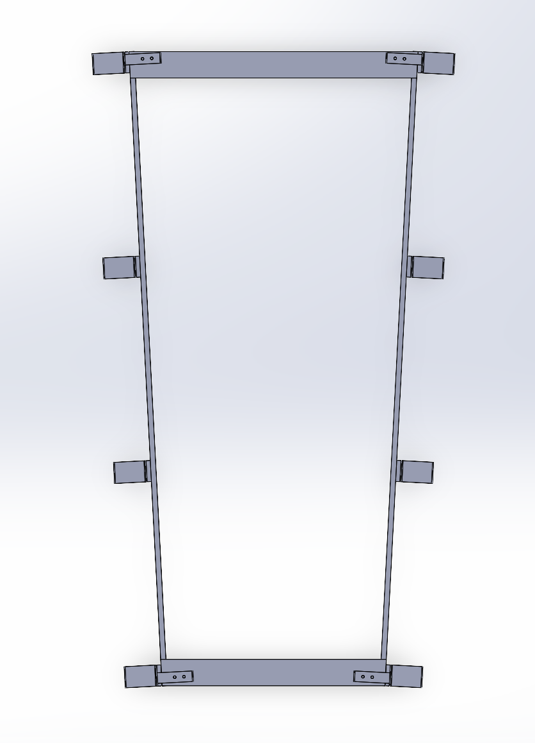
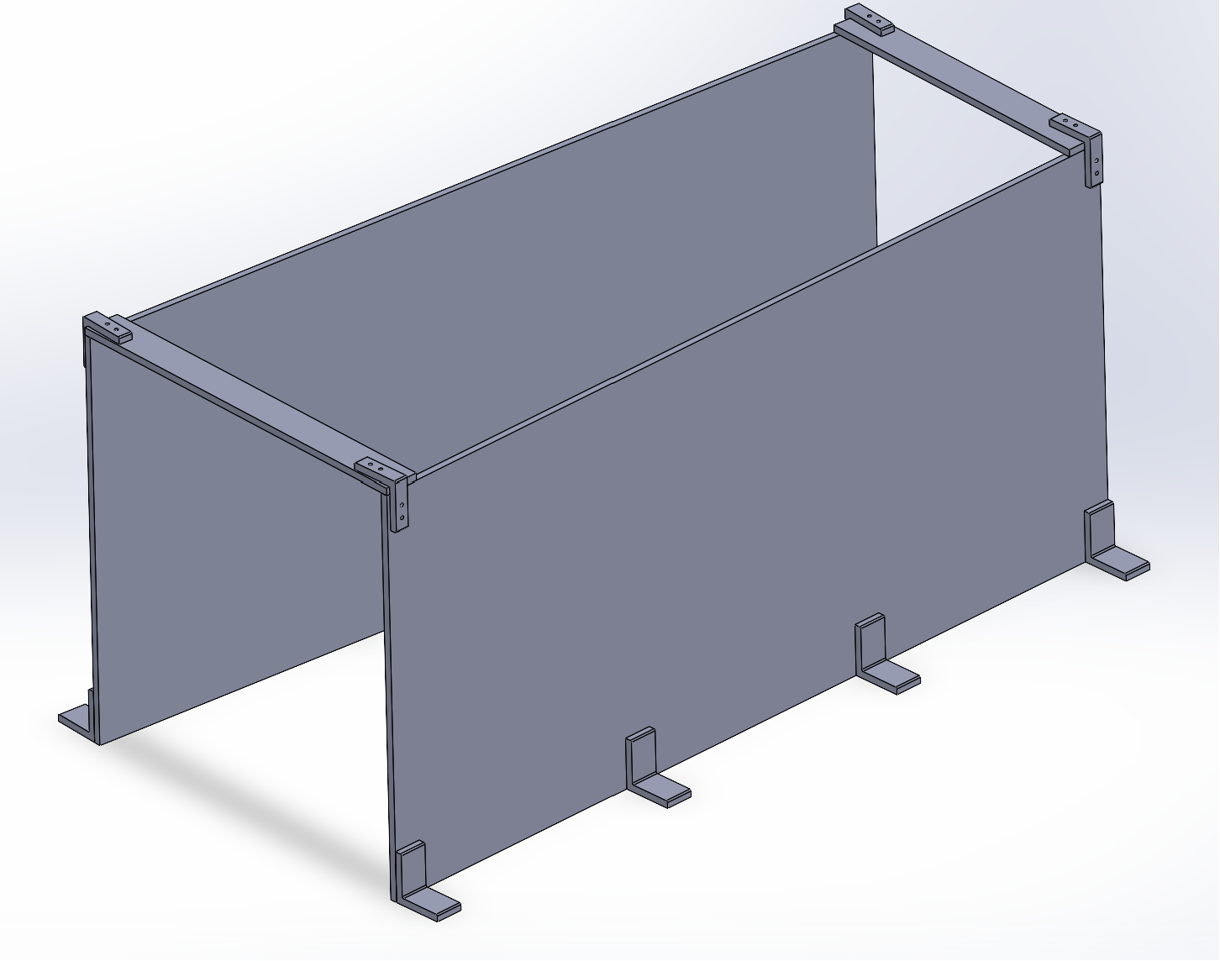
Blast Shield Design
Left top open to make room for plumbing
Plates are at an angle so fragments can be deflected and full force is not on the shield (also helps with blast wave)
Steel Plates are a big driver of cost
Just a bunch of carbon steel plate
Brackets can be angle iron
Chopsaw to cut them to length and quick mill operation to make the holes
Will require 48 screws

Slide 22
Transportation
Would need to separate the structure into multiple components to transport this
Ground plate would be one assembly
Rods + bearings + rest of the engine carriage assembly would be the second part
This way we could assemble the plates and then screw the rest of the assembly together.

Slide 23


BOM
*already have Load Cell (around ~380)

Slide 24

BOM Blast Shield
Total including Thrust Structure = $2190.64

Slide 25
Next Steps
ANSYS Analysis – Check modes of vibration (first 6 should be 0)
Expecting this to be fine
Ordering materials (lead times all within a week)
Building (1-2 weeks)
Cutting/Welding
Waterjetting
Mill for any holes not done by waterjet

Slide 26
Thank You!
Any Questions?

Slide 27





Appendix: Ansys sims
BCs: Face welded to I beam is a fixed support
5K lbf Load applied on the surface area of the hole
Ball Joint Connector

Slide 28





Appendix: Ansys sims continued
BCs: fixed support hole – transmitting force through it to the ball join then load cell
Engine to Ball Joint Support
5K lbf Load applied normally as shown

Slide 29




Appendix: Ansys sims continued
BCs: bottom face is a fixed support assuming being held in place by bearing brackets
Ring Bottom Piece
1K lbf Load applied axially in shear to the inner surface

Slide 30





Appendix: Ansys sims continued
BCs: holes of bolts are fixed support – assuming they are strong enough to handle the load
1K lbf Load applied axially in vertical direction to the inner surface upwards and downwards for the top face of the ends
Ring Bottom Piece
Stress intensity excluding the BCs

Slide 31




Appendix: Ansys sims continued
BCs: holes of bolts are fixed support – assuming they are strong enough to handle the load
1K lbf Load applied in shear to the inner surface

Slide 32

Appendix: Additional Earth Anchors
Added additional line of EAs in the soil
Only 10.85% interference
510 lb x 15 x .8915 =6,819.975 shear max load of EAs in soil

Slide 33

Appendix: EAs Not All The Way In
simulation where we dont get the EAs in all the way, so instead of the whole depth being 18in, it becomes 14"
47.05% of the volume (15 EAs total) that it would normally affect
Very little interference, but much less volume = much less strength
6,819.975lbf * .4705 =3208lbf

